Slide 1
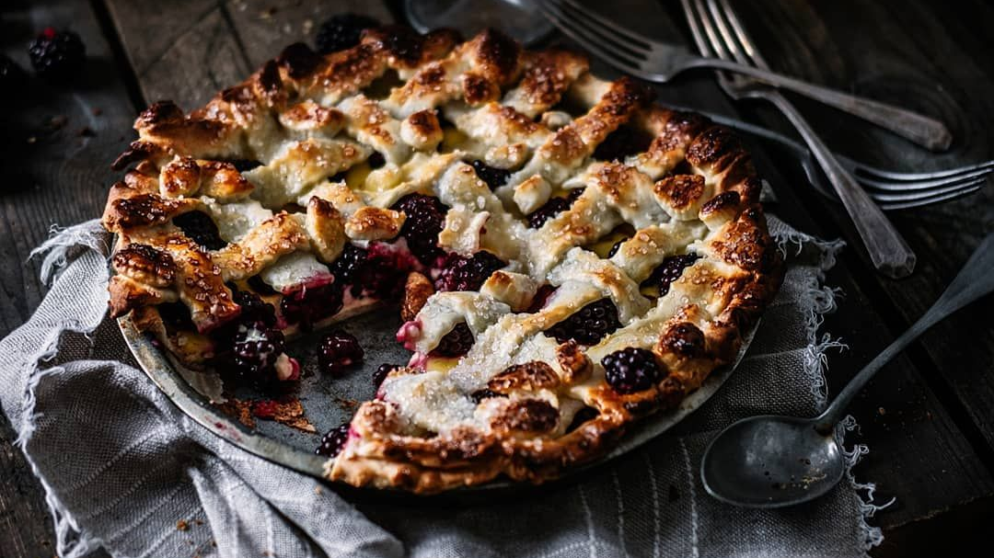
Bakery’s Pie Analysis
Task:
Help Pie Bakery to improve their business by gathering insights from the last two years of pie sales!

Slide 2
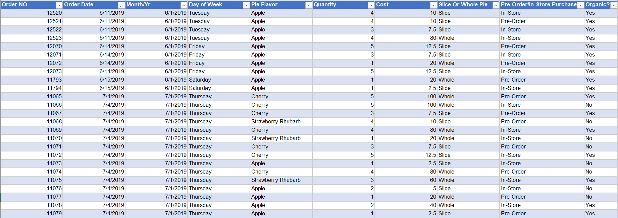
The data:
Starts from June 2019 to November 2021.
The bakery has 7 pie flavors.
The quantity of the pie ranges from 1 to 5.
The cost of the pie ranges from 2$ up to 100$.
There are two options of the pie slice or whole.
The purchase is done by two ways make in store or pre-ordered.
There are two types of ingredients Organic or not.

Slide 3







Pie Flavor Analysis
Apple and Strawberry produce the most revenue while blueberry produces the least.
Apple and Strawberry are ordered more in quantity.
Apple is the highest number of orders while blueberry is ordered less.

Slide 4
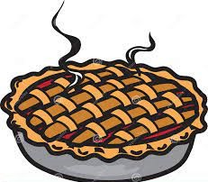


Size of the pie Analysis
Insights :
Whole pies generate revenue more than slice pies.
Whole pies are more in quantity and No of orders.
The whole pie has 8 slices, The cost of the slice is the same alone or in a whole pie, so there is no difference in buying a whole pie or just a slice.
Whole
Slice
Min Cost
20
2.5
Avg Cost
59.7
7.6
Max Cost
100
12.5

Slide 5
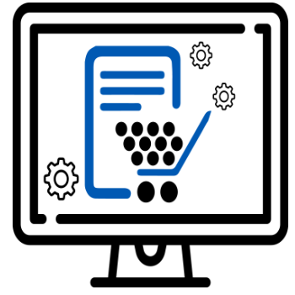
A purchasing System Analysis
Insights :
Pre-Order system produce more revenue, quantity and No of Orders.
Based on the analysis I did Apple flavor is more In-Store orders while the other Flavors are more in Pre-Order system.

Slide 6

Ingredient Analysis
Insights :
Organic pies produce revenue threefold the pies that don't have Organic ingredients.
Customers order the organic pies more, so the quantity and No of orders are so high compared to nonorganic pies.

Slide 7

Sales Analysis Over The past 3 Years
Insights :
Sales had increased more in April and November, respectively, The increase had happened because the occasions in these months.
Sales had increased more in the workdays more than the weekend.

Slide 8

Sales Forecasting Using Regression
2019
2020
2021
2022
Here I made Forecasting from Dec 2021 To Dec 2022.
The same trending that happened in Apr the last year will happen in this year too.

